Slide 1
RACEMOB
(burnout)
(pitwall)
(octane)
we can’t decide on a name
Aaron King
Andrew Lindstrom
Cody Allen
Connor Gannaway
Caleb Kornegay
Nic Lindsey
Peyton Davis

Slide 2

Reason
CAR GO VROOOM

Slide 3

Frontend
REACT NATIVE

Slide 4


Backend
DJANGO

Slide 5

Database
POSTGRES

Slide 6
Demo

Slide 7
Reason
Motorsport fans previously did not have a way to easily check stats from races. Solutions were Google or spending time navigating individual leagues’ websites.
“Borrowing” concepts of the FotMob and OneFootball apps, we created a solution that combines all information about drivers, teams, races, points, and more into one app, making it easy to find the information you want.
Our goal was to first implement F1 data, then later implement different motorsport competitions (NASCAR, IndyCar, MotoGP, WEC, DTM…)

Slide 8
Frontend
Stack Navigator nested inside of a Tab Navigator that allows you to save state across pages
React Native’s included Fetch API makes it easy to grab data from the API endpoints.
React Native Paper for the cards and React Native Material Icons for the tabs

Slide 9
API
/version
/messages
/messages/<pk>
/races/nearest
/races/<pk>
/races/<pk>/brief
/drivers
/drivers/<pk>
/teams
/teams/<pk>
/leagues
/leagues/<pk>
Django based REST API as the backend.
Responds to API requests made by the client application by querying multiple tables, piecing information together as json, and returning.

Slide 10
Database
Using PostgreSQL
Data is highly relational
Database is designed to accommodate data from different motorsports
~600,000 lines of F1 data dating back to the 1950s

Slide 11
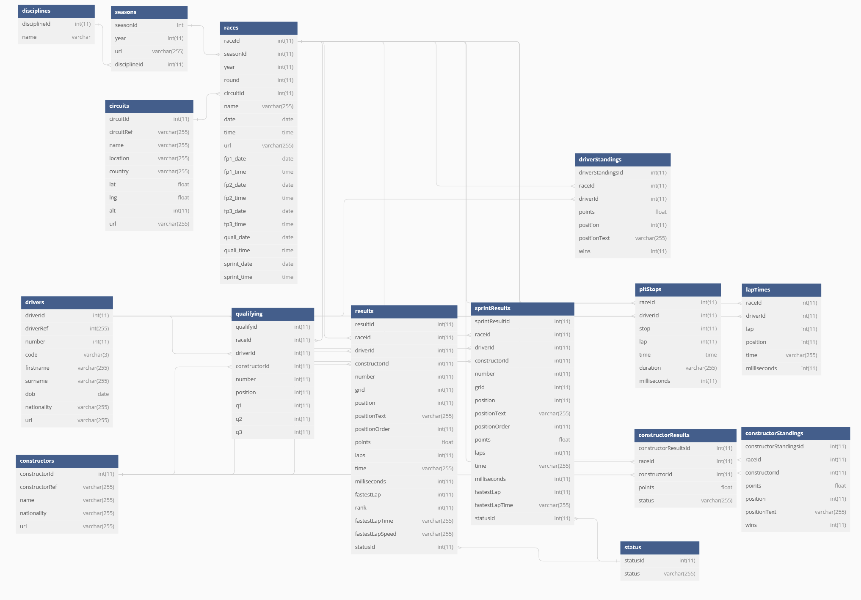

Slide 12
Deployment
User Client
Django Backend
Cloudflare Caching
Gunicorn
Postgres
EC2/Compute Platform
EC2/Database Platform

Slide 13
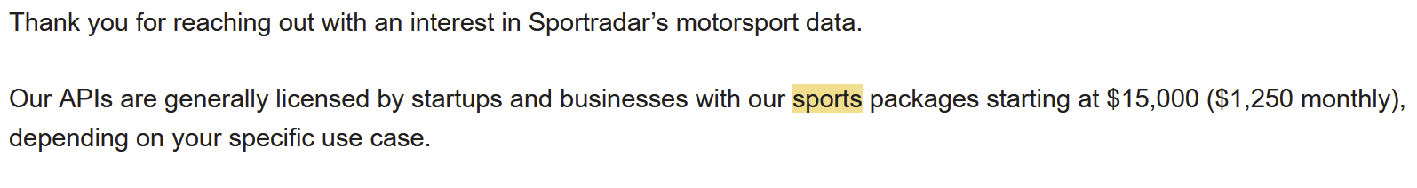
Next Steps
We aren’t using all of the data we have access to.
Live timing & notifications.
Incorporate other motorsports.
Google Ads (servers aren’t cheap)
Get VC funding so we can use SportRadar’s $15k/y APIs.

Slide 14
Questions?

Slide 16
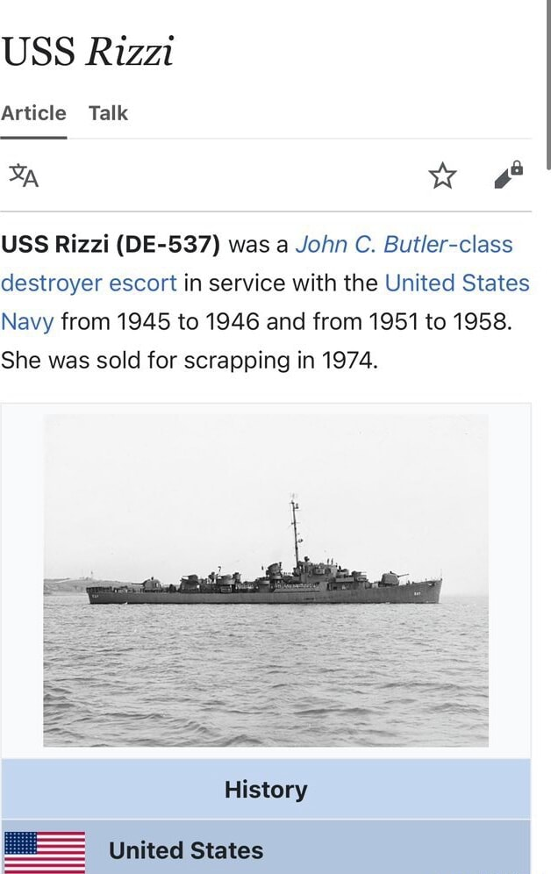
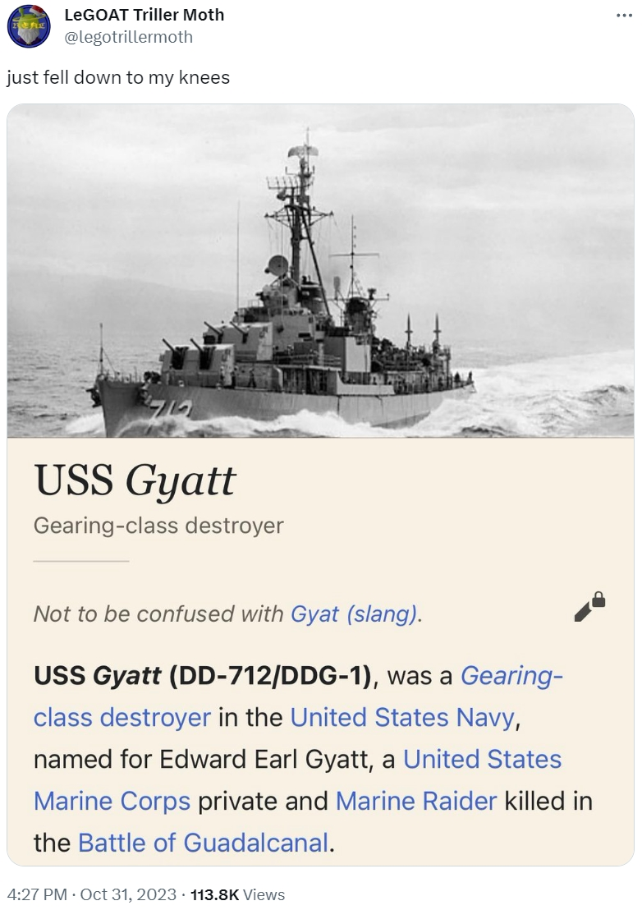
Naval Intermission

Slide 17
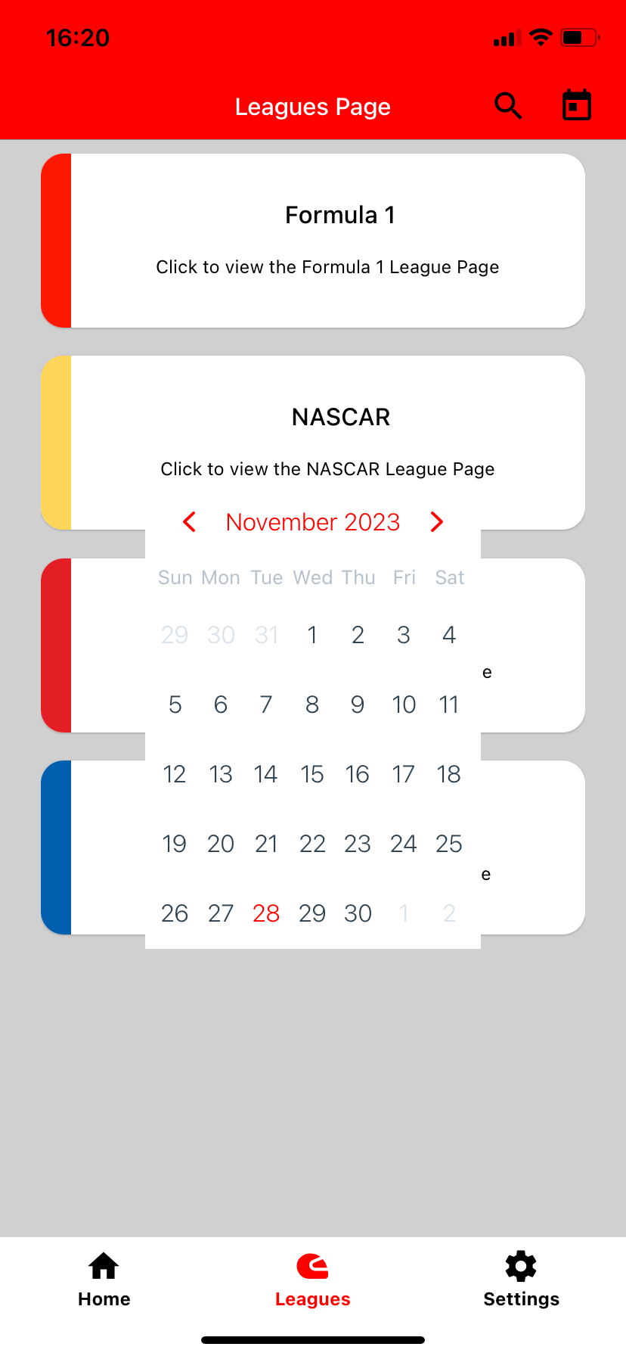
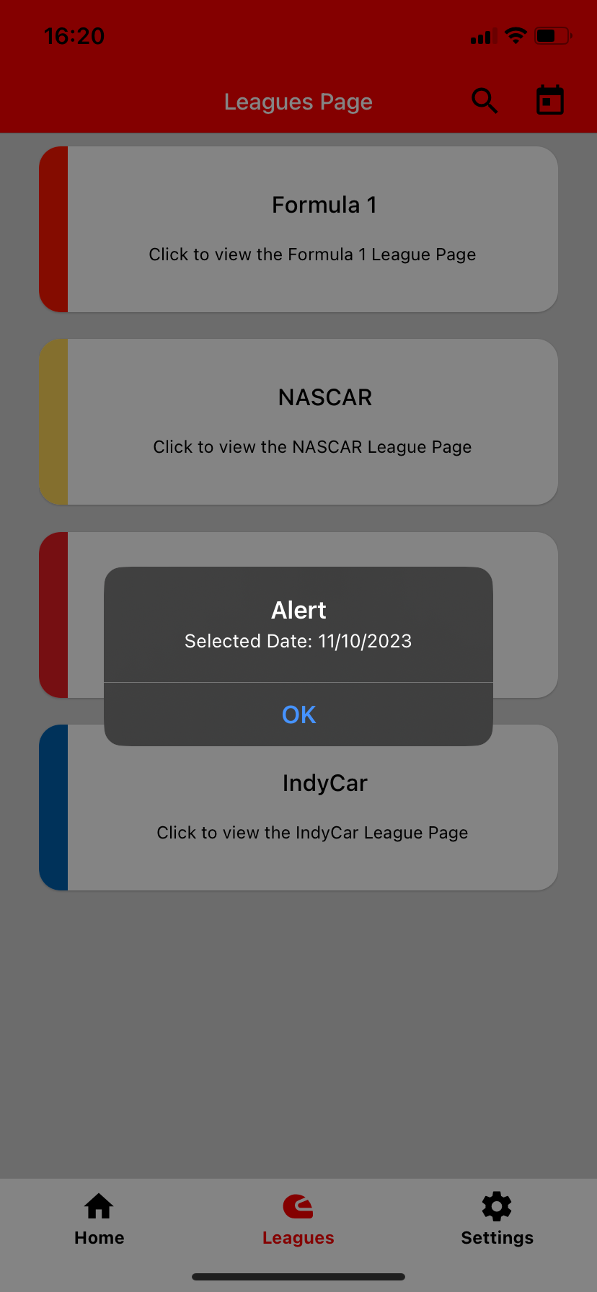
Calendar
Began as a date range, but decided we only needed a single day
This date affects the home screen and the leagues page.
Changes the query to the backend.

